Slide 1
Database Design for an Electronic Medical Record System
Advanced FEATURES
Shweta PATIL
MEETU UTHRA
TUSHAR ARVIND

Slide 2
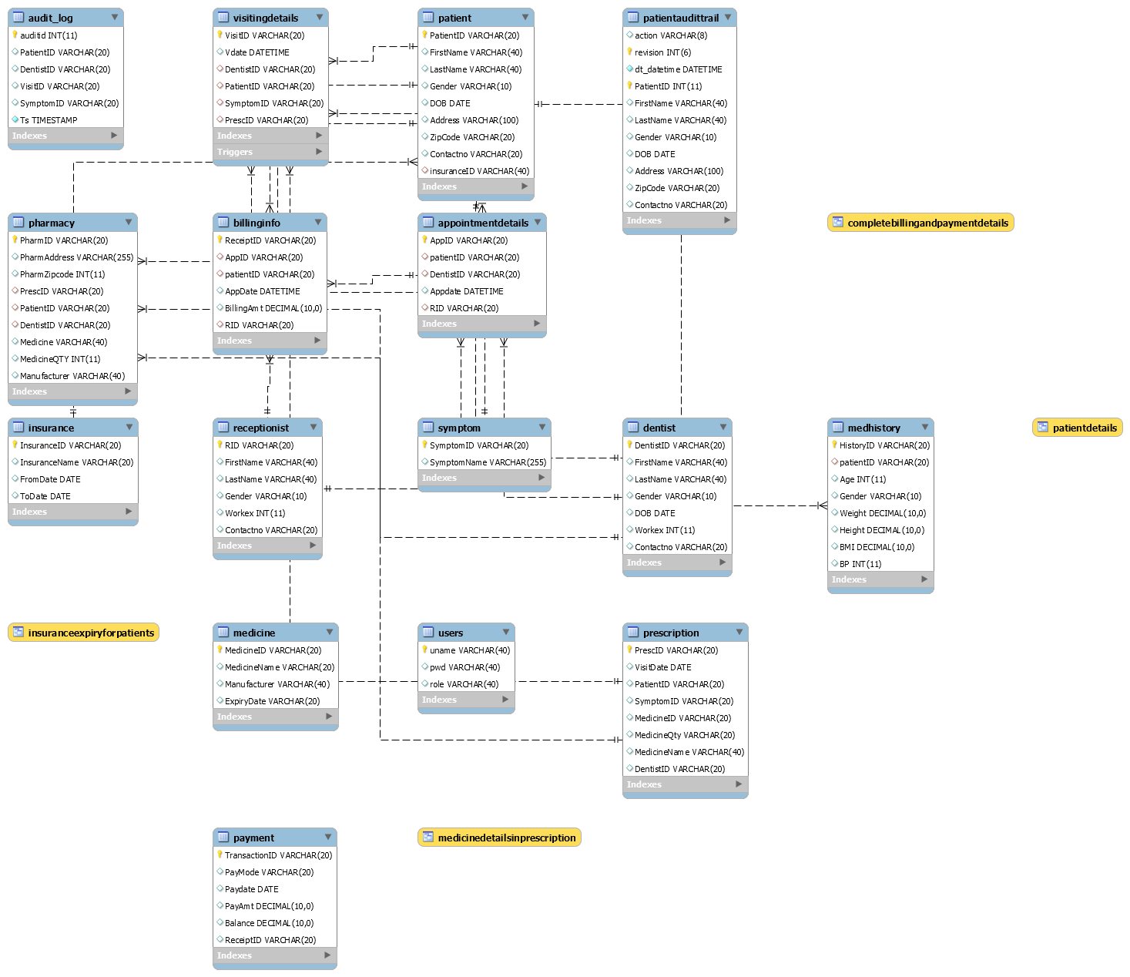

Slide 3
Agenda
Stored Procedures
User Authentication
Role-based authorized access control
Audit Trails
Views and Indexes

Slide 4
Stored PROCEDURES
Patient With Worn Fillings – accessible only to the dentists
Dentist with Work experience > 5 – accessible only to the patients
Billing details per appointment per patient – accessible only to the receptionists
Highest earnings – accessible only to the admin
Medicine details – only to the Pharmacists

Slide 5
User Authentication
Username and password based authentication

Slide 6
User Authorization
Authorization as per roles:
5 user roles defined:
Dentist
Receptionist
Patient
Pharmacist
Admin

Slide 7
Audit Trails
Achieved using Triggers
Audit Table logs every change of record that is made to the database is monitored and the entire history of the data in the database is captured.
Every time a record is accessed – updated, inserted, or deleted

Slide 8
Views
For Dentists to see patient history
For Dentist to see prescribed medicine during a particular appointment
For Receptionist to maintain patient visiting details
For Receptionist to maintain billing and payment details
For Patient to view his own details in the system

Slide 9
Thank you!

